Slide 1

Presentation
Kai Jin

Slide 2
Data Definition
RA--The Right Ascension of the gamma-ray source in the selected equinox. This was given in J2000 decimal degree coordinates in the original table.
Semi_Major_Axis_68--The semi-major axis of the error ellipse at 68% confidence, in degrees.
Position_Angle_68--The position angle of the 68%-confidence semi-major axis, from celestial North, positive toward increasing R.A. (eastward), in degrees.
Flux_1_100_GeV--The integral photon flux for 1 - 100 GeV, in photons/cm2/s.
Energy_Flux--The energy flux, in erg/cm2/s, in the 100 MeV to 100 GeV range obtained by spectral fitting from 100 MeV to 100 GeV.

Slide 3
Data Definition
Source_Type
agn(1) = other non-blazar active galaxy
bcu(2) = active galaxy of uncertain type
bin(3) = binary
bll(4) = BL Lac type of blazar
css(5) = compact steep spectrum quasar
fsrq(6) = FSRQ type of blazar
gal(7) = normal galaxy (or part)
glc(8) = globular cluster
hmb(9) = high-mass binary
mc(10) = molecular cloud
nlsy1(11) = narrow line Seyfert 1
nov(12) = nova
PSR(13) = pulsar, identified by pulsations
psr (14) = pulsar, no pulsations seen in LAT yet
pwn(15) = pulsar wind nebula
rdg(16) = radio galaxy
sbg(17) = starburst galaxy
sey(18) = Seyfert galaxy
sfr(19) = star-forming region
snr(20) = supernova remnant
spp(21) = special case - potential association with SNR or PWN
ssrq(22) = soft spectrum radio quasar
unk(0) = unknown

Slide 4
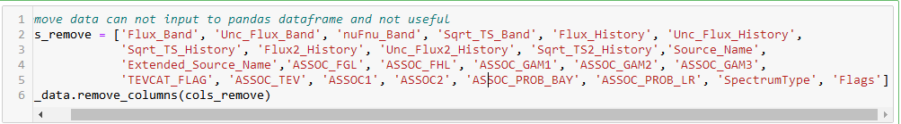
Process Data
Delete garbage data
1. Some data are collection that can be transfered to Pandas dataframe
2. Some data are string to describe specific situations

Slide 5
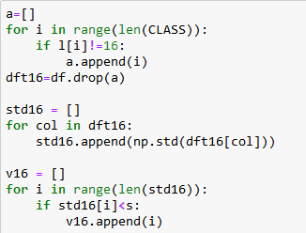
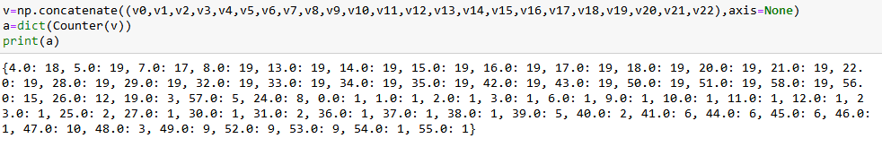
Process Data
Find terms are similar for identical stars
s=0.1

Slide 6
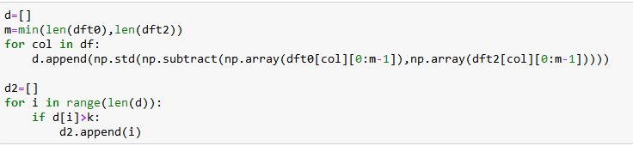
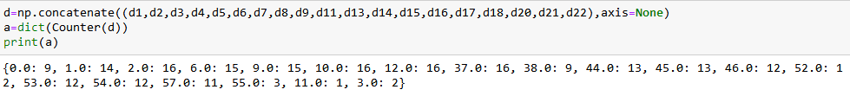
Process Data
Find terms have a larger differences for different stars
k=50

Slide 7
Process Data
Result
identity
4,5,7,8,13,14,15,16,17,18,20,21,22,28,29,32,33,34,35,42,43,50,51,58,56
identity drop cols
0,1,2,3,6,9,10,11,12,19,23,24,25,26,27,30,31,36,37,38,39,40,41,44,45,46,47,48,49,52,53,54,55,57
diff
0,1,2,6,9,10,12,37,38,44,45,46,52,53,54,57
diff drop
3,4,5,7,8,11,13,14,15,16,17,18,19,20,21,22,23,24,25,26,27,28,29,30,31,32,33,34,35,36,39,40,41,42,43,47,48,49,50,51,55,56

Slide 8
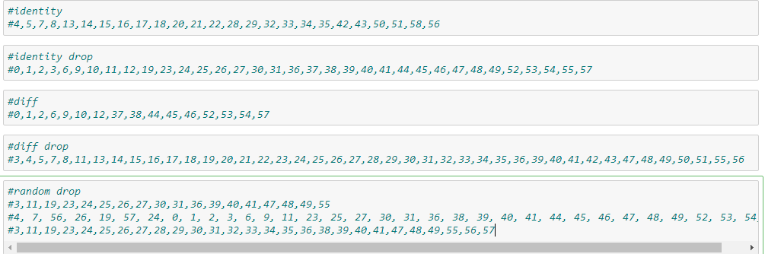
Trainning Data

Slide 9
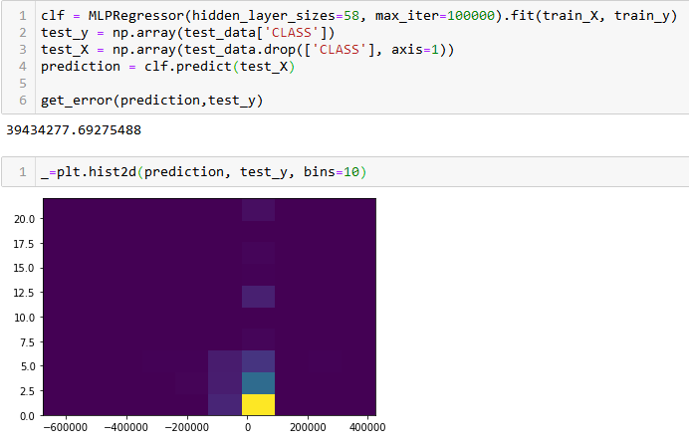
Why no NN

Slide 10
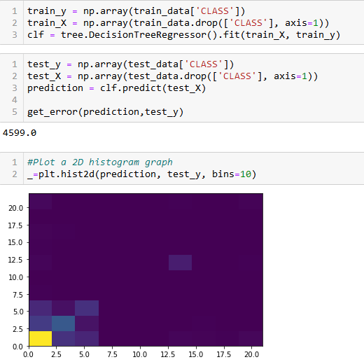
BDT Model
ave_error=1.81

Slide 11
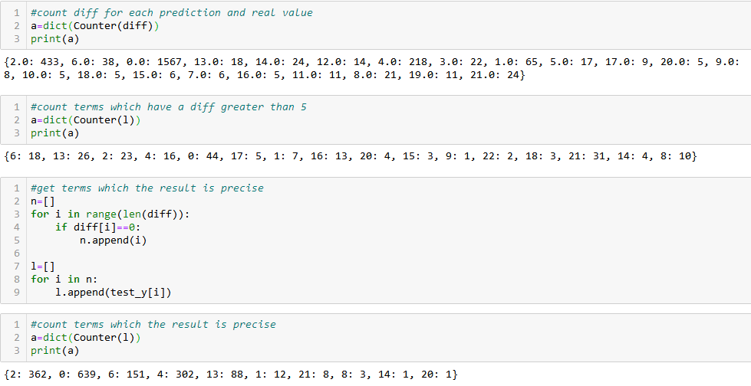
BDT Model

Slide 12
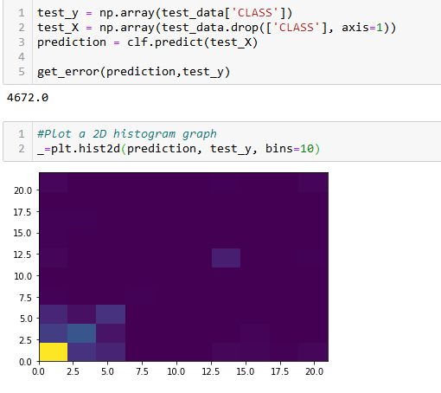
BDT Model 2
ave_error=1.85

Slide 13
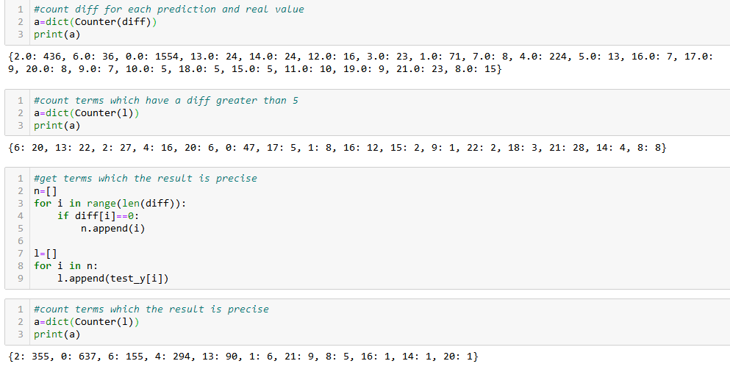
BDT Model 2

Slide 14
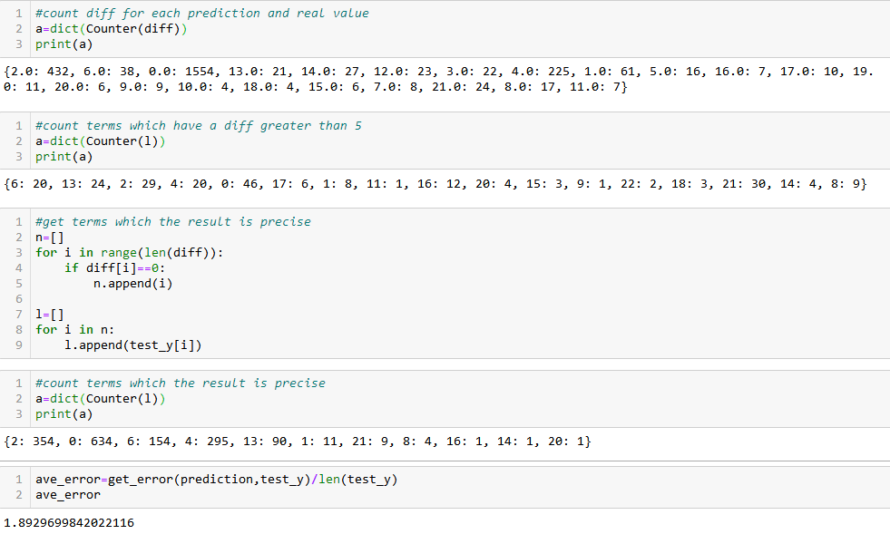
BDT Model 3

Slide 15
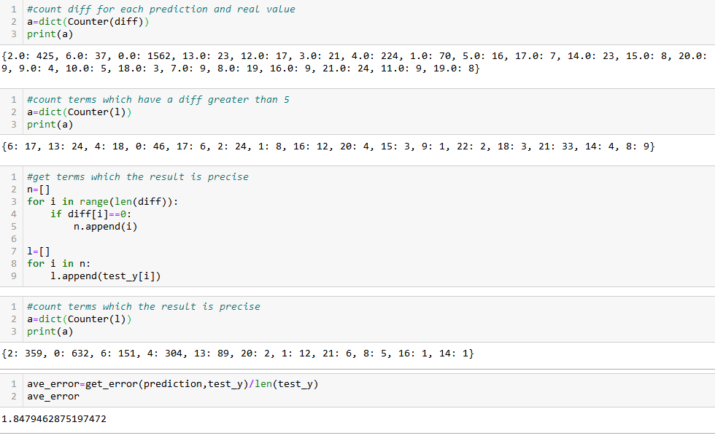
BDT Model 4

Slide 16
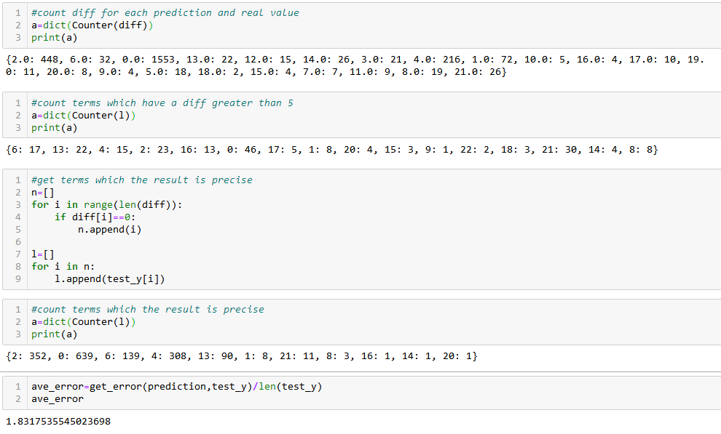
BDT Model 5

Slide 17
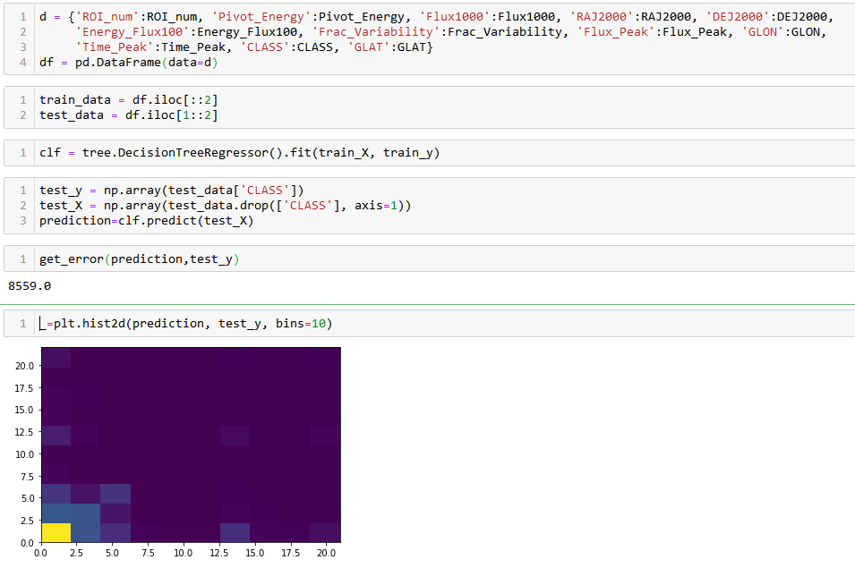
Comparable Group

Slide 18
Analysis
1. The accuracy of these models is not good
2. These models are better to predict type of active galaxy of uncertain type(2), FSRQ type of blazar(6), BL Lac type of blazar (4)and Unknown stars(0); it's a little better to predict pulsar, identified by pulsations(13)
3. The terms are similar in identical stars:
'Conf_68_SemiMajor', 'Conf_68_SemiMinor', 'Conf_95_SemiMajor', 'Conf_95_SemiMinor', 'Flux1000', 'Unc_Flux1000', 'Energy_Flux100', 'Unc_Energy_Flux100', 'PL_Flux_Density', 'Unc_PL_Flux_Density', 'Unc_PL_Index', 'LP_Flux_Density', 'Unc_LP_Flux_Density', 'PLEC_Flux_Density', 'Unc_PLEC_Flux_Density', 'PLEC_Expfactor', 'Unc_PLEC_Expfactor', 'PLEC_Exp_Index', 'Unc_PLEC_Exp_Index', 'Flux_Peak', 'Unc_Flux_Peak', 'Flux2_Peak', 'Unc_Flux2_Peak', 'CLASS', 'Unc_Counterpart'

Slide 19
Analysis
4. The terms have a larger diffenrence for different stars:
'RAJ2000', 'DEJ2000', 'GLON', 'Conf_68_PosAng', 'Conf_95_PosAng', 'ROI_num', 'Pivot_Energy', 'Npred', 'Variability_Index', 'Time_Peak', 'Peak_Interval', 'Variability2_Index', 'Time2_Peak', 'Peak2_Interval', 'RA_Counterpart',
5. There is no reduplicative terms in 3 and 4, it means there is not a obvious relationship can help determine star types in normal situations
6. The deleted data may contain some valuable information, however, I can not recognize

Slide 20

Thank you !

